Slide 1
Image Processing

Slide 2

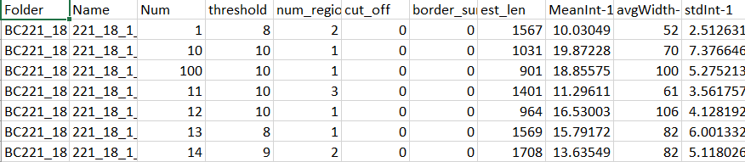
Overview
Ground Truth
Worm Image
Feature Extraction
Feature Exploration
Feature Selection
PCA and Heat Maps
LDA, Lasso, Stepwise Logistic Regression

Slide 3
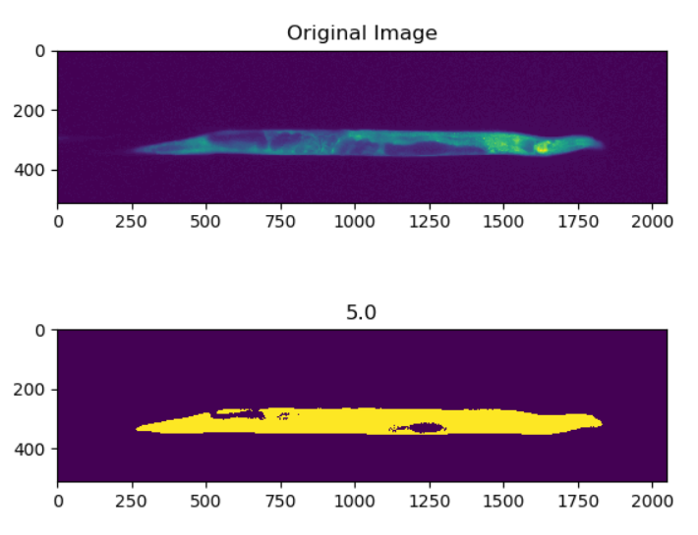
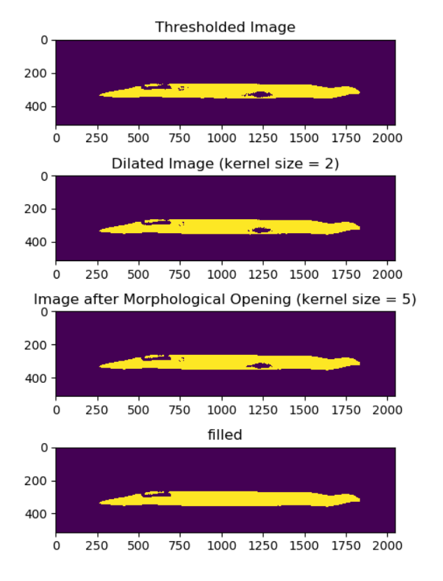
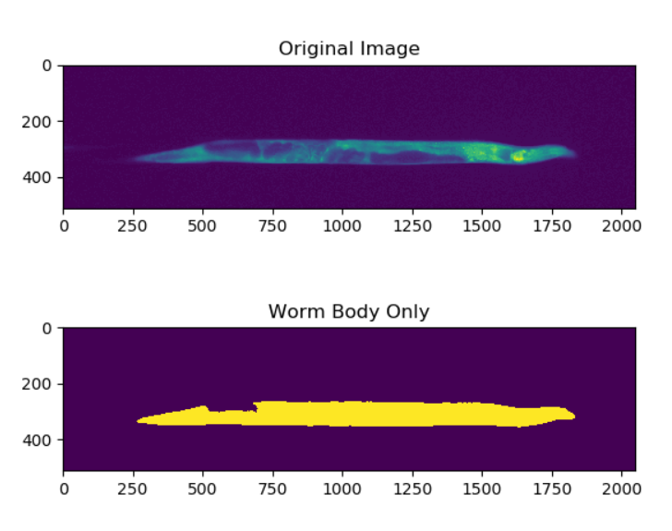
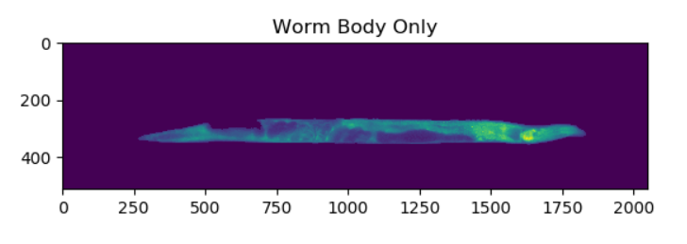
Feature Extraction
List of features we wanted to look at, how we determined those features
Worm Image

Slide 4
Feature Extraction

Slide 5
Feature Exploration
PCA/correlation, a few graphs

Slide 6
Feature Selection
L1 logistic regression

Slide 7
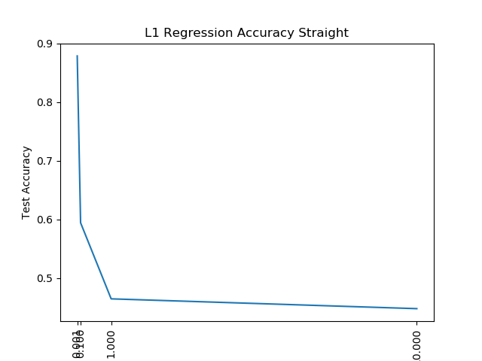
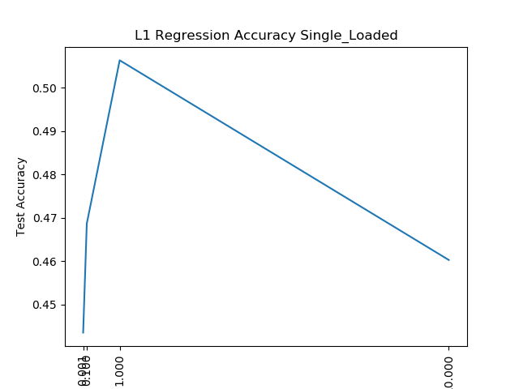
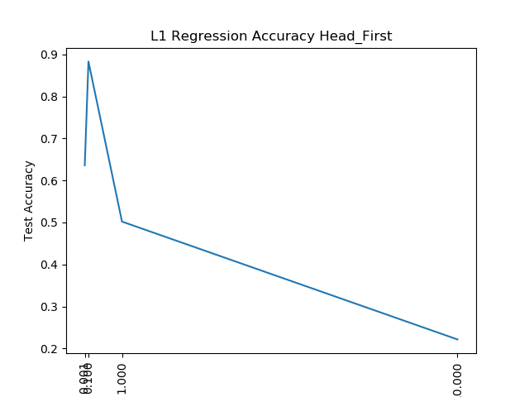
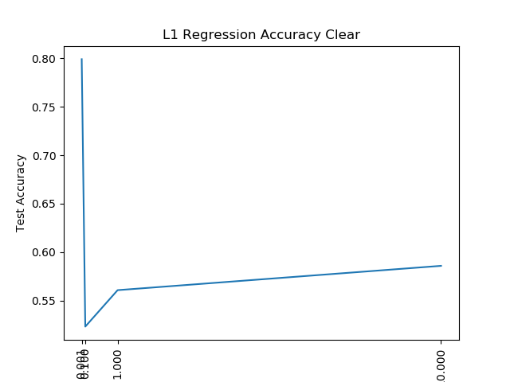
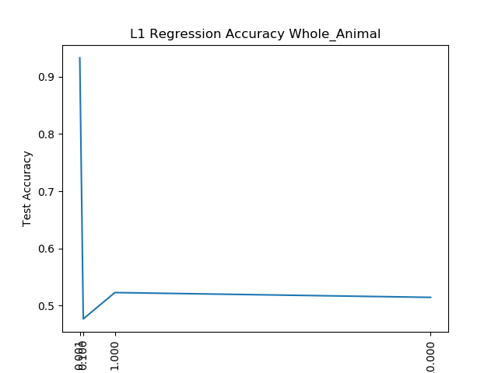

Slide 8
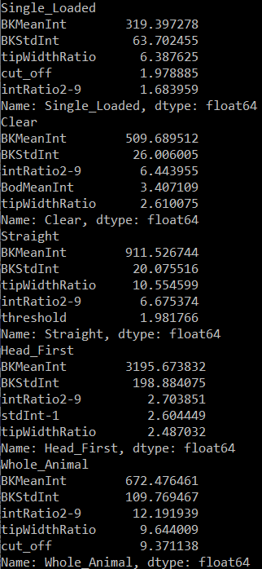
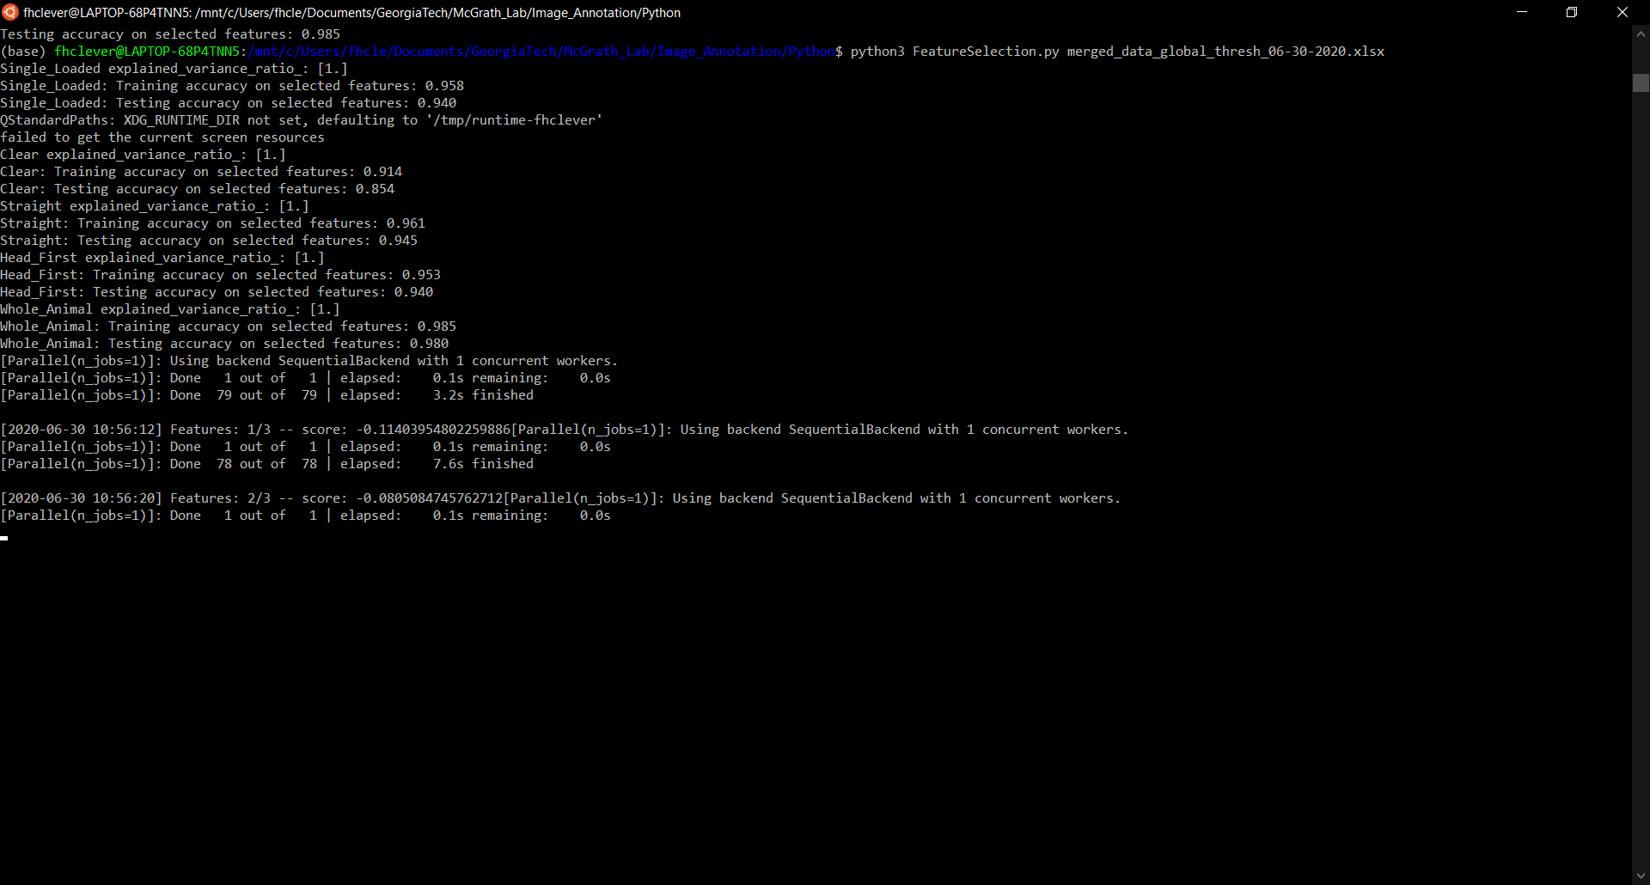
Feature Selection
LDA: only one component?
lda.explained_variance_ratio_ = [1.] for all five main features
Good training/testing accuracy for all

Slide 9
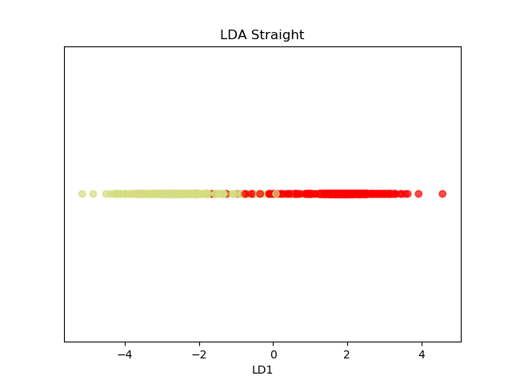
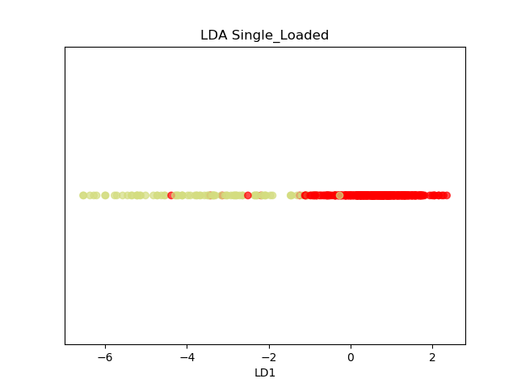
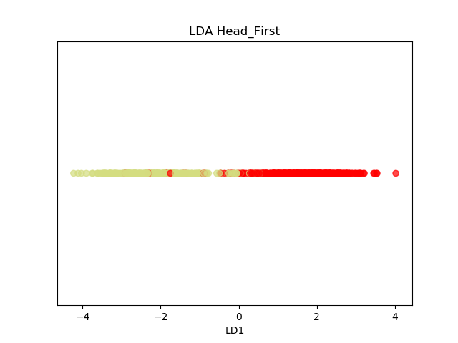
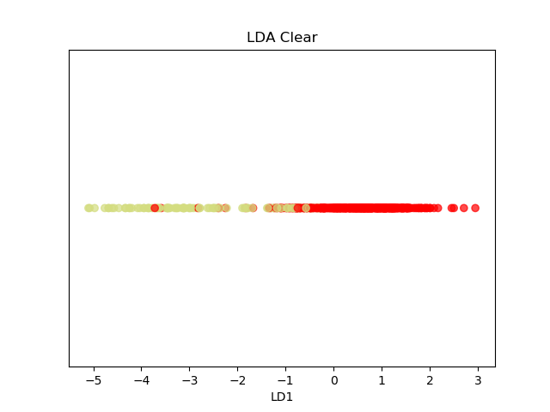
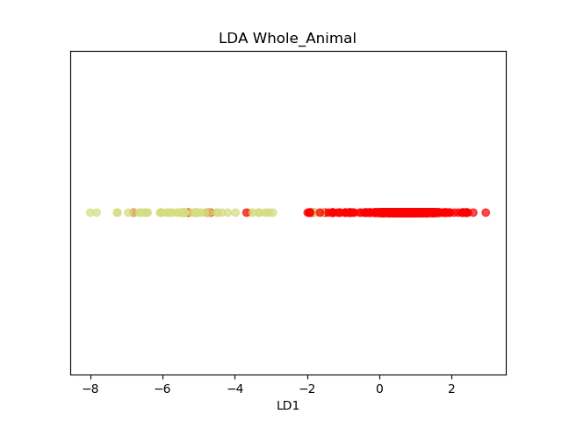

Slide 10
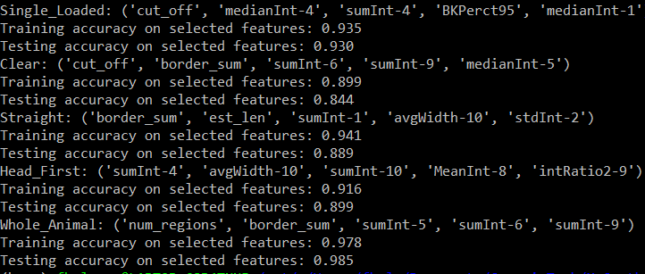
Feature selection
Step forward logistic regression
Good training/testing accuracy for all
What type of classifier to use?

Slide 11
